Slide 1


AI Agents and Automation: Choosing the Right Tool for the Job
Learn how automation and AI agents differ, when each approach works best, and how they can combine to help businesses move faster with more confidence.
BUSINESS STRATEGY
AI & AUTOMATION

Slide 2
The Core Problem
The Real Challenge: Knowing Which Tool to Use
Businesses often struggle to know when to use automation versus AI agents. The challenge isn't choosing the most advanced option — it's matching the tool to the task.
The Decision Gap
Choosing automation when a process needs AI flexibility
Choosing AI agents when a simple workflow would do
Unclear boundaries between repeatable tasks and adaptive tasks
Unnecessary complexity in early planning
Using the wrong approach can waste time, increase costs, and create more complexity than necessary. The real opportunity is understanding the strengths of each method so teams can make better decisions from the start.
The Result
Wasted resources
Slower delivery timelines
Less effective solutions

Slide 3


The Key Distinction
AI and Automation Aren't Competing — They're Often the Same System
The Common Assumption
The Reality
Businesses often treat automation and AI as separate choices — as if adopting one means excluding the other. This creates unnecessary confusion when planning workflows.
AI is frequently a node or component within an automation workflow. Tools like n8n, Make, and Zapier all support AI nodes — meaning your automation can trigger, process, and act, with AI handling the steps that require reasoning or interpretation.
Think of it this way: automation is the pipeline. AI is one of the tools that runs inside it. A workflow can be 90% automated rules with a single AI step for classification, extraction, or generation — and that's perfectly by design.

Slide 4
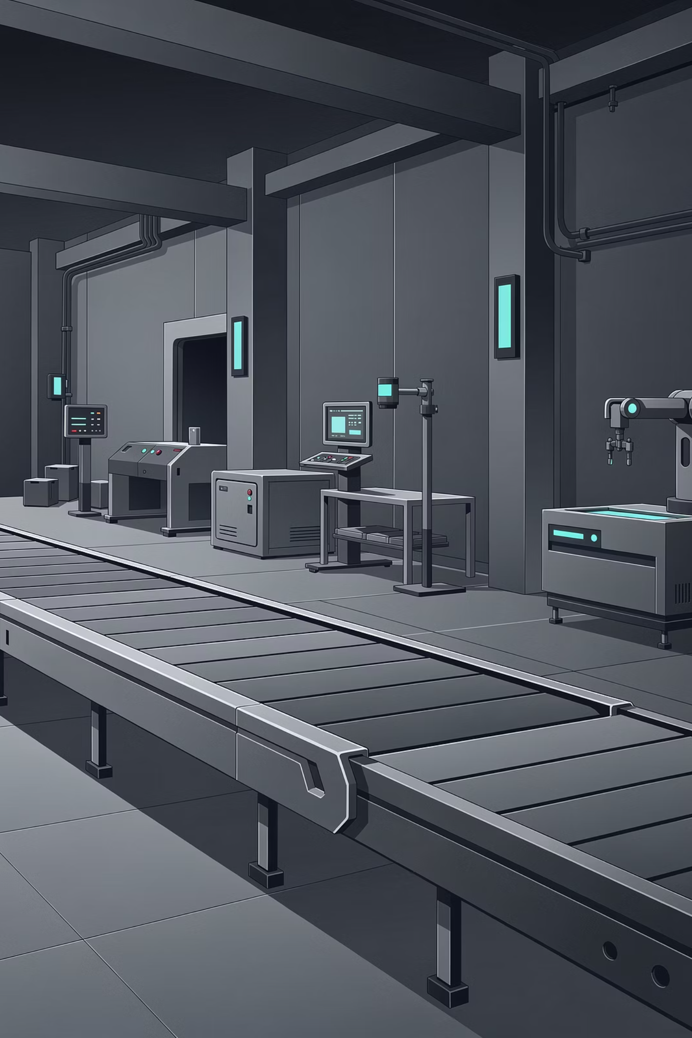
Chapter 1 of 3
What Is Automation?
Rule-based execution. Deterministic. Reliable. Fast. Automation is the workhorse most businesses already need and underutilize.

Slide 5

Automation: Rule-Based Execution at Its Best
Core Characteristics
Real Examples
Deterministic
Form Submission Trigger
Data Sync
Same input always produces the same output — no variance, no surprises.
Move structured data between systems on a schedule or event trigger.
When a form is submitted → validate fields, create a CRM record, and notify the right team. Zero ambiguity, zero judgment needed.
Fast & Predictable
Executes at machine speed with no latency introduced by probabilistic processing.
Low Cost
Workflow Triggers
Efficient to build and scale — pure automation runs on predictable compute with no per-inference costs. Hybrid workflows that include AI nodes will have additional costs, but these are typically far less than equivalent manual effort.
Fire a downstream process when a condition is met — no human needed.
Automation removes repetitive work — not thinking. It doesn't interpret; it executes.

Slide 6

Chapter 2 of 3
What Is AI?
Probabilistic decision-making. Flexible. Powerful. Scalable. AI interprets language and context where rules break down.

Slide 7
AI: Flexible, Scalable, and Context-Aware
What AI Does Well
Key Considerations
Language Interpretation
Requires Good Inputs
Understands context, tone, and ambiguity that rules can't capture.
Output quality reflects input quality. Well-structured prompts and clean data lead to consistently strong results.
Content & Summarization
Writes, condenses, and reformats unstructured text at scale.
Designed for Variability
Meaning Extraction
Unlike rigid rules, AI handles a range of inputs — which is a strength, but means outputs should be validated for high-stakes decisions.
Pulls structured insights from messy, inconsistent input data.
Cost vs. Human Labor
Per-call costs are real, but often far less than the human time required to do the same work manually.
AI adds flexibility where rules fall short — and when set up well, it delivers consistent, scalable results at a fraction of the cost of manual effort.

Slide 8
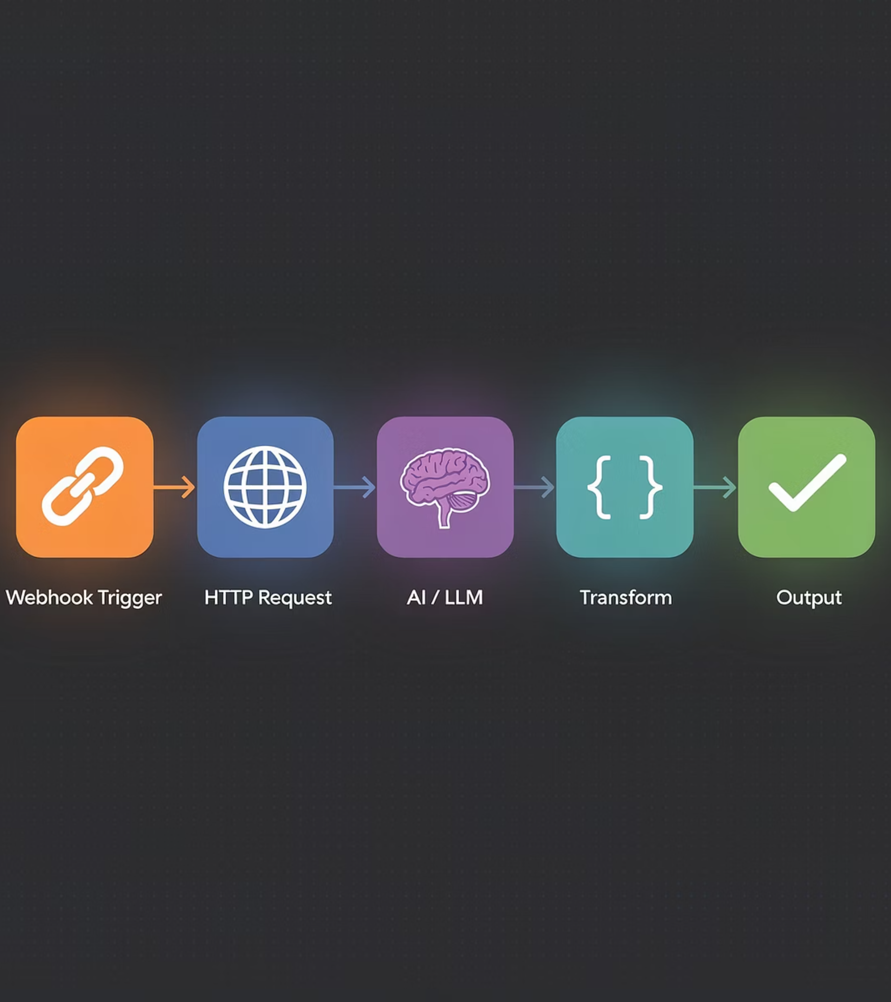
Chapter 3 of 3
What Is an AI Agent?
AI + Tools + Memory + Decision Loops. Agents are the most powerful and adaptive option in the stack.

Slide 9
AI Agents: Powerful, Flexible, and Built for Complexity
An AI agent combines a language model with tool access, memory, and the ability to take multi-step actions dynamically. It doesn't follow a fixed script — it reasons its way through a task, adapting at each step.
Multi-Step Reasoning
External Tool Use
Breaks down complex goals and determines the next action at each step.
Calls APIs, queries databases, and interacts with outside systems.
Memory & Context
Improves Over Time
Retains information across steps using vector databases or session memory.
Well-architected agents become more reliable as prompts, tools, and workflows are refined — and deliver compounding value as they scale.

Slide 10

LLMs vs. AI Agents: What's the Difference?
Both use large language models at their core — but how they're used in a workflow is fundamentally different. Understanding this distinction is key to building the right solution.
AI / LLM in a Workflow
AI Agent
Single-Step Execution
Stateless by Default
Multi-Step Execution
Stateful & Context-Aware
The LLM receives an input, generates an output, and stops. One prompt in, one response out.
No memory between calls. Each invocation is independent unless context is manually passed in.
The agent decides what to do next at each step — calling tools, evaluating results, and continuing until the goal is met.
Maintains memory across steps, tracks progress, and adapts based on what it has already done.
You Control the Logic
Best For
The surrounding workflow (automation or code) decides when to call the LLM, what to send, and what to do with the result.
Classification, extraction, summarization, generation — discrete tasks with a clear input and output.
The LLM Controls the Logic
Best For
The agent uses the LLM as its reasoning engine — deciding which tools to call, in what order, and when to stop.
Research, multi-step problem solving, dynamic workflows where the path isn't known in advance.
An LLM is a tool. An agent is a system built around that tool. In a workflow, an LLM node does what you tell it — an agent figures out what needs to be done.

Slide 11





Matching Complexity to the Right Tool
The right tool depends on the nature of the task — not the sophistication of the technology. Map your problem to the right point on the spectrum before choosing a solution.
Automation
AI / LLM
Structured inputs, predictable outputs, high volume. Rules handle it efficiently and reliably.
Unstructured inputs, context-dependent outputs. Reasoning and interpretation required.
AI Agent
Hybrid
Multi-step goals, dynamic decisions, tool use. The workflow adapts as it progresses.
Automation handles the pipeline; AI or agents handle the steps that need judgment. Most real-world solutions land here.
These aren't mutually exclusive categories — they're layers. A single workflow can move through all four depending on what each step requires.

Slide 12

Each Approach Has Its Strengths
Automation Strengths
AI Agent Strengths
Speed
Handles Ambiguity
Executes fast and consistently for high-volume workflows.
Can work with incomplete, messy, or changing inputs.
Reliability
Adapts to Context
Produces predictable outcomes when the process is well defined.
Adjusts responses based on the situation, user needs, and surrounding signals.
Cost-Efficiency
Multi-Step Reasoning
Pure automation runs on predictable compute costs. When AI nodes are added to a workflow, costs remain manageable and are typically a fraction of equivalent human labor.
Can break down complex problems and chain actions together.
Scales to Complex Tasks
Predictability
Useful when the work requires judgment, synthesis, or dynamic decision-making.
Rule-based logic stays stable as long as the rules and inputs stay stable.
Learns from Feedback
Easy to Maintain
Can improve over time as systems, prompts, and workflows are refined.
Simple workflows are straightforward to debug, update, and monitor.
Both approaches are powerful. The key is knowing when to deploy automation for predictable work and when to use AI agents for more ambiguous, complex tasks.

Slide 13




Key Decision Framework
Choosing the Right Tool for the Job
Before choosing a solution, ask what kind of work the task actually requires. Use this framework to match the problem to the right level of intelligence and automation.
Use Automation
Use AI / LLM
Task is repetitive, inputs are structured, and the output is predictable. Best for rules-based workflows and high-volume execution.
Task needs reasoning, summarization, interpretation, or handling ambiguity. Best when context matters more than fixed rules.
Use AI Agent
Use Hybrid
Task requires multi-step decisions, tool use, and dynamic goals. Best when the workflow must adapt as it progresses.
High-volume triggers need automation, but complex edge cases need judgment. Combine automation for the front end with an agent for exceptions.
The goal is not to avoid agents — it’s to use the simplest tool that solves the problem well. The right answer may be automation, an LLM call, an agent, or a hybrid of all three.

Slide 14

The Real Opportunity
Building Intelligent Systems That Scale
The real opportunity is not choosing between automation and AI agents — it's combining them strategically. Businesses that know when to automate and when to deploy agents will move faster, spend smarter, and build more resilient systems.
Automate What’s Repetitive
Deploy Agents Where Judgment Matters
Use rules and workflows for high-volume tasks with structured inputs and predictable outcomes.
Bring in agents for multi-step decisions, ambiguity, and tasks that need reasoning or adaptation.
Design for Speed & Resilience
Strategic orchestration helps teams ship faster, control costs, and create systems that scale with confidence.

Slide 15
Key Takeaway
The most effective businesses don't choose between automation and AI — they know when to use each.
They build systems that combine both intelligently — solving their most important problems with the right level of complexity, and scaling with confidence as their needs evolve.
Start With the Problem
Match the Tool to the Task
Build for Growth
Define what you're trying to solve before choosing a technology. The right tool becomes obvious when the problem is clear.
Automation, AI, agents, or a hybrid — each has a place. The best solutions use the right approach for each part of the workflow.
Well-designed systems scale. Start with what solves the problem today, and architect for the intelligence you'll add tomorrow.

