Slide 1

How to Use AI in Business: A Practical Strategy Guide
A clear framework for choosing the right AI implementation approach — from stand-alone tools to agents and automation systems.
BUSINESS STRATEGY
AI & IMPLEMENTATION

Slide 2
The Real Question
Businesses Have Moved Past "Should We Use AI?"
The question is no longer whether to use AI — it's how to use it and where it actually fits. Most businesses now have access to powerful AI tools. The challenge is choosing the right implementation approach for the right problem.
The Real Challenge
Too many AI options with unclear distinctions
Choosing complexity when simplicity would do
Starting with technology instead of the problem
No clear framework for matching tools to tasks
Getting this wrong means wasted investment, mismatched tools, and solutions that don't scale. Getting it right means faster workflows, lower costs, and compounding value over time.
The Opportunity
A clear decision framework
Four distinct implementation paths
Choose the right approach for each task — intentionally

Slide 3


Mental Model
The Four Ways to Use AI — A Framework for Choosing the Right Approach
The Common Mistake
The Better Approach
Businesses assume agents are always the most advanced option — and that APIs are simpler. The real distinction is architectural: who controls the logic? Choose based on that, not perceived complexity.
Map your problem to the right approach. The best choice is the one that fits the task architecturally — who needs to control the logic, what scale is required, and how much AI autonomy the task demands.
The four approaches: Stand-alone tools → Third-party platforms → API integrations → Agents & automation. Each serves a different purpose — the right choice depends on who needs to control the logic, the scale required, and the level of AI autonomy the task demands.

Slide 4

Approach 1 of 4
Stand-Alone AI Tools
Instant access. No setup. Maximum flexibility. Stand-alone tools are often the best option in their category, not just a starting point. Many are purpose-built for specific use cases like image generation, video, audio, design, and coding that APIs, agents, and third-party platforms don’t replicate.

Slide 5

Stand-Alone Tools: UI-Based AI for Individuals
What It Is
Strengths & Limitations
Direct Interface Access
Strengths
Specialized Use Cases
Using AI through platforms like ChatGPT, Claude, or Gemini — no code, no API, no setup required.
Instant access, no setup — switch between tasks, models, and formats on the fly.
Purpose-built for specific domains — image generation, video, audio, design, and coding — and remain the best option in their category.
Common Use Cases
Writing & editing, brainstorming, research & summarization, quick data interpretation.
Best For
Workflow Limitations
Cost Considerations
Individuals and ad-hoc tasks where speed of access matters more than workflow integration.
Not integrated into workflows — manual effort per task, no inherent automation, limited memory, no scale.
Monthly subscriptions, per-seat pricing, or usage-based credits — costs compound quickly across multiple tools.
The lowest barrier entry point — ideal for exploration, individual productivity, and specialized workflows.

Slide 6

Approach 2 of 4
Third-Party Platforms
Fast implementation. Built-in integrations. Low technical barrier. AI embedded inside tools your teams already use every day.

Slide 7

Third-Party AI Platforms: Scale Without Heavy Development
What It Is
Strengths & Limitations
AI In Your Existing Tools
Strengths
Limitations
AI capabilities built into software you already use — Microsoft Copilot, Salesforce Einstein, Notion AI, Google Workspace AI.
Fast implementation, built-in integrations. Teams adopt quickly without deep engineering support.
Less customization than API approaches. Vendor dependency, subscription costs, and platform boundaries apply.
Embeddable AI Systems
Pre-built AI chat and support assistants designed to embed into your website or support system with minimal configuration — no custom development required. Examples: Tidio, Freshdesk.
Common Use Cases
CRM automation, document workflows, reporting & insights, no-code automations.
Best For
Teams scaling quickly without custom development or engineering overhead.
The fastest path to team-wide AI adoption — trading flexibility for speed. Best for organizations that need results now.

Slide 8

Approach 3 of 4
API-Based AI
Scalable. Repeatable. Fully customizable. Embedding AI directly into business systems via API calls to language models.

Slide 9

API Integrations: Embedding AI Into Business Systems
What It Is
Strengths & Limitations
Direct Model Calls
Production Pipelines
Strengths
Limitations
Making programmatic calls to models like OpenAI or Anthropic. Prompt + input → structured output at scale.
Content generation, classification & tagging, data enrichment, and email drafting — running at volume inside business systems.
Maximum control and flexibility. Repeatable, scalable, and fully tailored to your workflow — no platform boundaries.
Requires engineering resources to build and maintain. Prompt engineering is a skill. Production systems must handle failures, edge cases, and validation logic.
Full Customization
You control the prompts, logic, inputs, and outputs — built exactly to your business requirements.
API integrations are the foundation of scalable AI in business — repeatable, customizable, and designed to run inside production systems at volume. APIs and agents are parallel architectural choices, not sequential steps.

Slide 10

GOING DEEPER
API-Based AI: The Engine Behind Scalable Solutions
Why APIs Are the Core of AI Development
What Scalable API Systems Look Like
Precision at Scale
Input → Process → Output
Same logic runs thousands of times with consistent, measurable outputs. AI becomes a business asset, not just a productivity aid.
A business input passes through an LLM with a defined prompt and returns a structured output.
APIs and Agents: Parallel Patterns
Chained Calls
Agents are built on top of API calls — but they are a different architectural pattern, not a more complex version of the same thing. Use APIs when your code should direct the flow; use agents when the AI should.
Complex workflows chain multiple API calls together, each step feeding the next.
Human-in-the-Loop
Review steps let humans validate or override AI outputs before they affect downstream systems.
Ownership of the Stack
You own the logic, prompts, and outputs. No vendor constraints — build exactly to your requirements.
APIs and agents are not on a complexity ladder — they are architecturally different. APIs keep your code in control. Agents hand control to the AI. Start with the approach that fits the task, not the one that sounds most sophisticated.

Slide 11

REAL-WORLD IMPLEMENTATION
API-Based AI in Practice: What the Build Actually Looks Like
Common Deployment Environments
Customer-Facing Website
Internal Staff Portal (SharePoint / Intranet)
AI assistant embedded in your site, answering questions from product docs and FAQs via a RAG pipeline. Well-designed implementations include a human escalation path — handoff to live chat or a support ticket — for queries the AI cannot confidently resolve.
AI assistant embedded in SharePoint or your intranet — staff get instant answers from internal documents, reducing support tickets.
CRM & Support Platforms
Custom Internal Tools
AI embedded into Salesforce, HubSpot, or Zendesk — summarizing tickets, drafting responses, and classifying issues in real time.
AI wired into dashboards or ops tools — generating reports, flagging anomalies, or drafting communications from live business data.

Slide 12
REAL-WORLD IMPLEMENTATION
API-Based AI: The Tech Stack
Foundation Layers
Delivery & Access Layers
The LLM Layer
The Interface Layer
The reasoning engine — OpenAI, Anthropic, or Google, accessed via API.
Chat widget, Teams bot, Slack integration, or custom UI — wherever your users are.
The Data Layer (RAG)
Authentication & Security
Content stored in a vector database and retrieved before each LLM call.
Identity providers ensure users only access authorized data.
The Middleware / Orchestration Layer
Frameworks like LangChain or LlamaIndex manage retrieval, prompts, memory, and API calls.
Tools shown are illustrative. The five layers are consistent across most implementations — tools vary by organization and infrastructure.

Slide 13
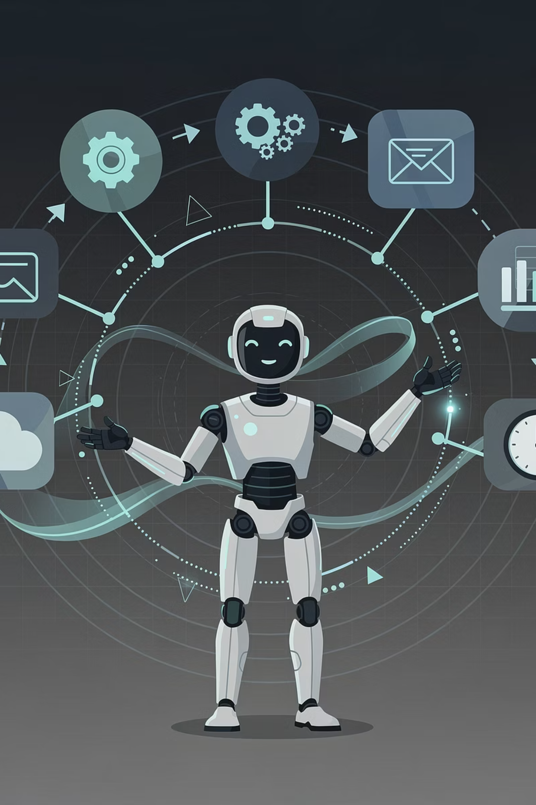
Approach 4 of 4
Agents & Automation
AI + Workflows + Decision Logic + Tool Use. An architectural choice, not a complexity level. Agents range from simple to sophisticated — what defines them is that the AI controls the logic, not your code.

Slide 14

Agents & Automation: AI-Directed Logic in Action
The distinction between APIs and agents is architectural — not about complexity — it's about who controls the logic.
Multi-Step Orchestration
Dynamic Reasoning
Handles end-to-end process flows — from trigger to output — across multiple systems and decision points.
AI agents adapt at each step — deciding what to do next based on context, not a fixed script.
Tool & System Integration
API vs. Agent: Who Controls the Logic?
Calls APIs, queries databases, and interacts with external systems as part of the workflow.
API call: Your code controls the flow. AI receives a prompt and returns a response — what happens next is defined by your pipeline. Agent: The AI controls the flow. It decides what tool to call and what step comes next, within boundaries you define. A simple n8n agent with two tools is still an agent. A complex chained API pipeline is still not.
Agents are not inherently more complex than API pipelines — they are architecturally different. Choose agents when you need the AI to make decisions about flow. Choose API pipelines when you want your code to stay in control.

Slide 15




Core Strategy
Choosing the Right Approach: A Decision Framework
Before choosing a solution, ask what the task actually requires. Four key drivers should shape your decision — not the sophistication of the technology.
Problem Type
Scale
Repetitive → Automation / API
Ambiguous → Stand-alone or API-based AI (depending on scale)
AI-directed flow → Agent (code-directed flow → API pipeline)
Individual → Stand-alone
Team → Third-party tools
Enterprise → API / automation
Control Needed
Risk Tolerance
Low → UI tools
Medium → Third-party platforms
High → API / custom systems
Low → Deterministic automation
Medium → AI-assisted workflows
High → Autonomous agents
The biggest mistake: starting with technology instead of the business problem. Define what you're solving first — the right approach becomes obvious.

Slide 16
Common Mistakes — And How to Avoid Them
Most AI implementation failures aren't technical — they're strategic. Knowing what to avoid is as important as knowing what to build.
The Most Common Mistakes
The Root Cause
Overbuilding
Starting With Technology
The Correct Starting Point
Choosing agents when your code should stay in control — or choosing API pipelines when the AI actually needs to direct the flow. The mistake is mismatching the architecture to the task, not simply choosing agents early.
The most common failure pattern: picking a technology first, then finding a problem to justify it. This leads to solutions that are over-engineered, expensive, and hard to maintain.
Always start with the problem. What is repetitive? What is slow? What requires interpretation? The right implementation approach follows naturally from an honest answer.
Chasing Trends
Adopting AI because it's popular, not because it solves a real, defined business problem.
Ignoring Maintenance
Underestimating the ongoing cost and complexity of maintaining AI systems in production.
No Success Criteria
Launching without defining what "working" looks like — making it impossible to measure ROI.

Slide 17
Layering AI: The Advanced Approach
Stand-Alone AI → Ideation
Third-Party Platforms → Team Adoption
UI-based tools for brainstorming, drafting, and early-stage creative work.
Put AI in the hands of your broader team — fast, with minimal friction.
API → Production Workflows
Agents → Adaptive Workflows
Embed AI into core business systems for repeatable, scalable, customized execution.
Use when the AI needs to control the flow — deciding what tool to call and what step comes next.
Automation → Execution
Rules-based automation for structured, high-volume tasks — reliable and cost-efficient.
AI becomes a capability layer — not a single solution. The goal is strategic orchestration: matching each part of your workflow to the approach that handles it best.

Slide 18

Practical Business Strategy
Build From Simple to Complex — Not the Reverse
The most effective AI strategy starts with the lowest-complexity solution that solves the problem. Add layers only when genuinely needed.
1. Identify Repetitive Work
2. Automate Where Possible
Map your workflows and find the tasks that are high-volume, structured, and predictable. These are your first automation candidates.
Apply rule-based automation before introducing AI. Automation is faster, cheaper, and more reliable for deterministic tasks.
3. Add AI Where Interpretation Is Needed
4. Introduce Agents When the AI Needs to Control the Flow
Introduce API-based AI or third-party AI tools for steps that require reasoning, classification, or handling of ambiguous inputs.
Use agents when the task requires the AI to decide what to do next — not your code. This is an architectural choice, not a complexity upgrade. A simple agent may be the right call even early in your build.

Slide 19





Real-World Example
Customer Intake Process: AI in Practice
Here's how a customer intake process looks when each step uses the right approach — automation, API, or agent.
Form Submission
AI Classifies the Request
Customer submits a form → automation validates fields, creates a CRM record, and routes to the right queue. Pure automation — no AI needed.
An API call to an LLM reads the submission and classifies the request type — routing it appropriately. One AI step, not an agent.
Routing Logic
Agent for Edge Cases (Optional)
Automation applies routing rules based on the classification output — escalating, assigning, or triggering next steps. Back to pure automation.
Only for complex, ambiguous cases that fall outside standard rules — an agent handles dynamic resolution. Most requests never reach this step.
Most value is achieved in Steps 1–3. The agent in Step 4 is an architectural choice — introduce it only when the data tells you the AI needs to control the flow, not your code.

Slide 20
Key Takeaway
AI is not a single tool — it's a capability. The advantage comes from knowing how to apply it.
Businesses that win with AI choose the right approach for each problem — and build toward sophistication intentionally, not by default.
Multiple Implementation Paths
Simpler Often Delivers More
Execute with Confidence
Stand-alone tools, API integrations, agents, and third-party platforms each have a place. The right answer depends entirely on the problem.
The most valuable solutions are the ones that fit the task. The right approach — whether a stand-alone tool, an API pipeline, or an agent — is the one that solves the problem well, not the one that sounds most sophisticated.
Start with what solves the problem today. Measure results. Add a different approach only when the task genuinely requires it.

